Slide 1
Rotary Club of Plymouth
May 5, 2023
President Elect Chris Porman presiding

Slide 2
This

Slide 3
Welcome to rotary!
Meditation – June Kirchgatter
Broadcaster – Bill Weber
Introduction of Guests

Slide 4
Lunch signup
Sign up is important
Salad Options
If you can’t sign up electronically, call or email Marie
734-453-6879 x4
Marie.morrow@pcuw.org
Maurice Salad
Caesar with or w/o chicken
Greek with or w/o chicken
Spinach with or w/o chicken
Mediterranean

Slide 5
It’s Lunch Time
Please invite our guests to go first
Meeting will resume in about 20 minutes

Slide 6
SURVEY
If you haven’t had an opportunity yet, please fill out the brief survey

Slide 7
Music in the air
Be the face of Rotary Club of Plymouth
Promote Rotary Programs
Arrive at 6:30
Need a coordinator
June 16th, July 21st, August 18th
No regular meeting that day. Instead, meet at Rotary Park for Fellowship, then go to concert

Slide 8
Centennial museum project
NEEDED
Broadcasters from 60s, 70s, 80s.
Artifacts
Pictures
President gavels
Broadcaster Writers – You are writing history. Be specific, name names, provide dates members joined
This Photo by Unknown Author is licensed under CC BY-NC-ND

Slide 9
Canada Here we come!
Help Russ Jones kick off his DG year
Receive the Home of the District Governor banner
Tuesday, June 27
Red Pop & Sunflower Seeds at 5:30
Dinner at 7:00
RSVP to Penny by June 6
Working on a bus! Depart at 4:00?

Slide 10
Post Office Food Drive for Salvation Army
Saturday, May 13th
Need help at the following Post Offices collecting food and bringing to Salvation Army
Canton Post Office
Plymouth Post Office
Help is also needed the following week (Monday-Wednesday) sorting the food
If interested, please email: Kris.Wood@usc.salvationarmy.org

Slide 11
Get these dates on your calendar
May 20 – Flower Planting – Main Street 8:30 – 10:30
May 22 - Golf Outing
May 26 – Music in the Air Concerts begin – sign up for prime seating
Meet the Governor – June 27

Slide 12
Paul Harris Fellow & Introduction of Speaker
Danny Hyman

Slide 13
Diversity, Equity and Inclusion Bosch North America
Erin Dewsbury Ribeiro
Bosch North America DEI Officer
May 5th, 2023

Slide 14
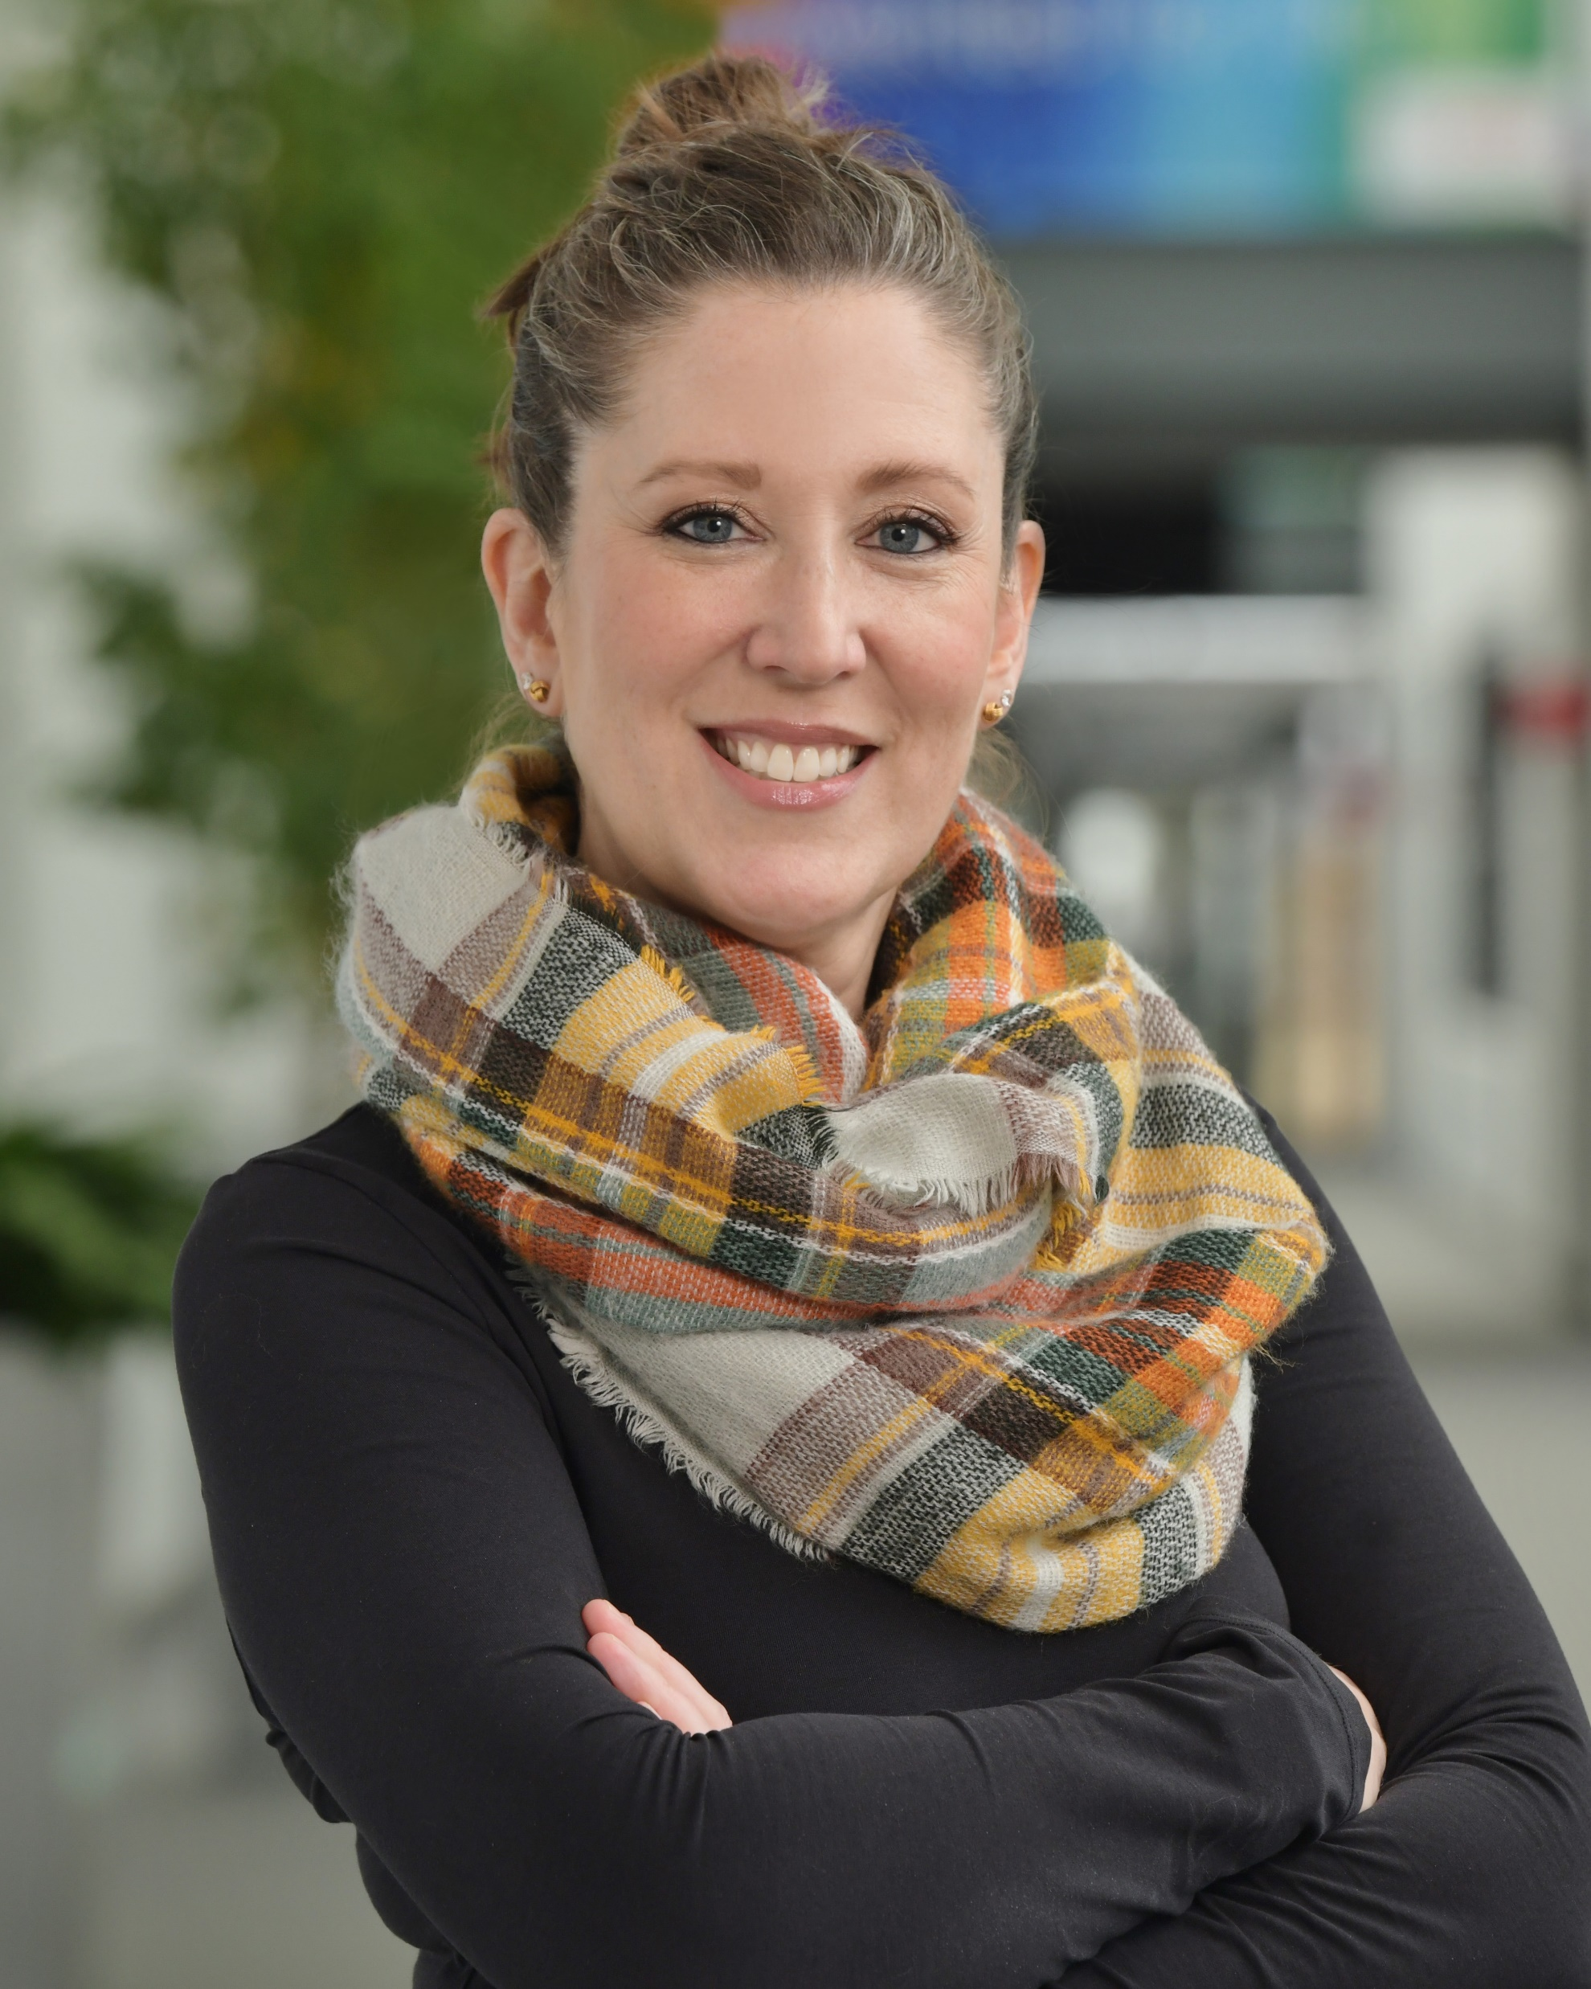
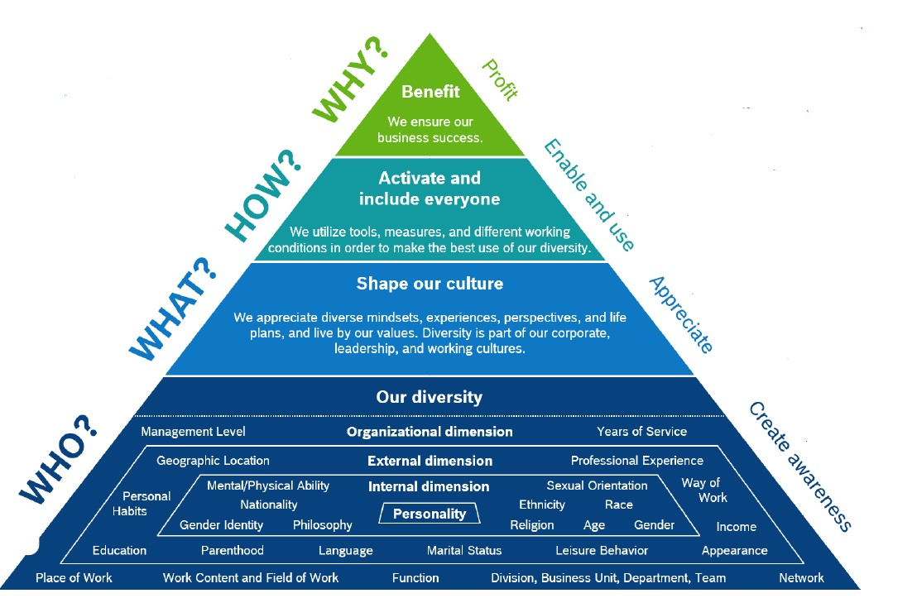
Introduction
Diversity, Equity and Inclusion in North America
Erin Dewsbury Ribeiro (she/her)
Diversity, Equity, Inclusion Officer
Bosch North America
Unique things about me:
Mom of 3 kids
Wife
Avid reader
VP of African Ancestry@Bosch
Studied 5 languages
Lived in Japan and Germany
Certified Project Manager at Bosch
DEI Commitment Statement: Diversity, Equity, and Inclusion is a cornerstone of our Bosch values, and we believe in the right of everyone to experience dignity, safety, and respect. Our commitment and belief that diverse perspectives and inclusive behavior are key enablers of our business, making us stronger as a company.

Slide 15
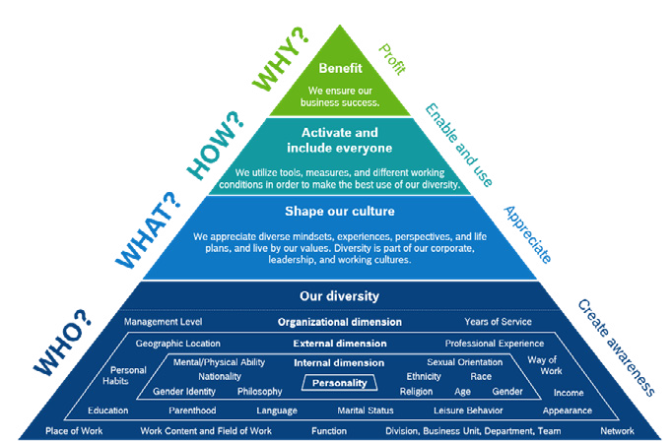
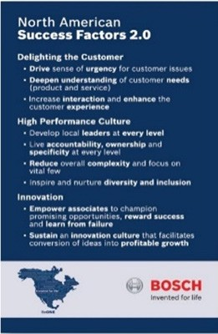
Our DEI Journey
Diversity, Equity and Inclusion in North America
2013-2015
Diversity Day
Diversity Conference
D&I Ambassador Program
Inclusive Leadership Training
2018-2019
Cross-Collaboration and University Relations
Advancing Diversity in Leadership (ADL) Sponsorship Program
Global Launch Diversity Model
Supported CSR Initiatives
Today
RP Reverse Mentoring Program
TA & DEI Strategic Partnerships established
Diversity Days Engagement
More robust DEI Ambassador Network
Driving BRG business impact
2011
Diversity Journey Begins
2016-2017
Hired Full-Time D&I Lead
D&I Summit
Added D&I to NASF Framework
Growth of Multiple Business
Resource Groups (BRGs) and Leadership Programs
2020-2021
Added Equity to our D&I Framework
Diversity Week Engagement
Optimized Talent-Acquisition Process
Launched DEI Leadership Guide
Launched Two New BRGs

Slide 16
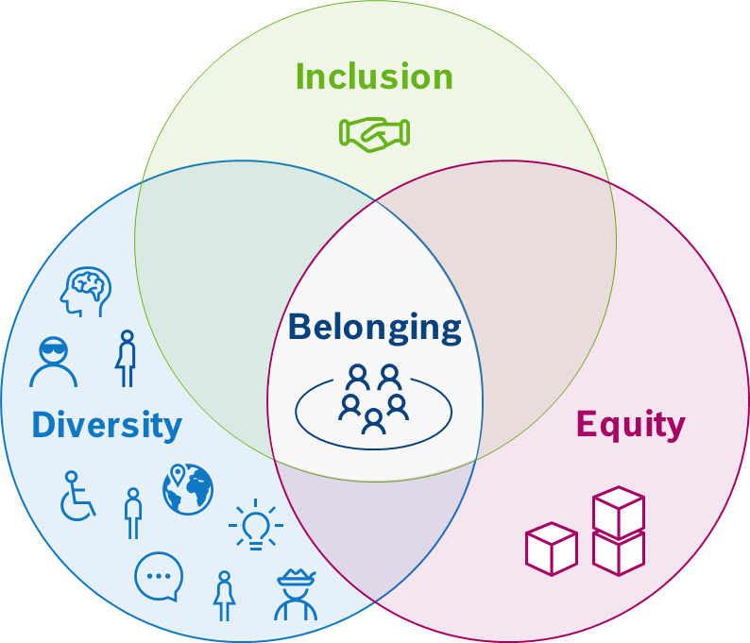
What is DEI?
Diversity, Equity and Inclusion in North America
Inclusion: The extent to which an individual in the organization feels valued as a team member. Maximizing the full potential of each individual, the organization is able to develop and sustain a high-performance culture.
When we live DEI, associates are more motivated, perform better and enjoy working at Bosch – because they feel a high sense of belonging.
Belonging means feeling safe when there is a sense of identity as a member of a group of people.
Diversity: The different personal backgrounds individuals can bring to a group. When leveraged, this diversity enhances the group’s potential to achieve greater effect and influence.
Equity: Based on our social identifiers we all have varying levels of access to resources.
Equity strives to make the necessary systemic changes to ensure everyone has fair access to what they need to succeed.

Slide 17
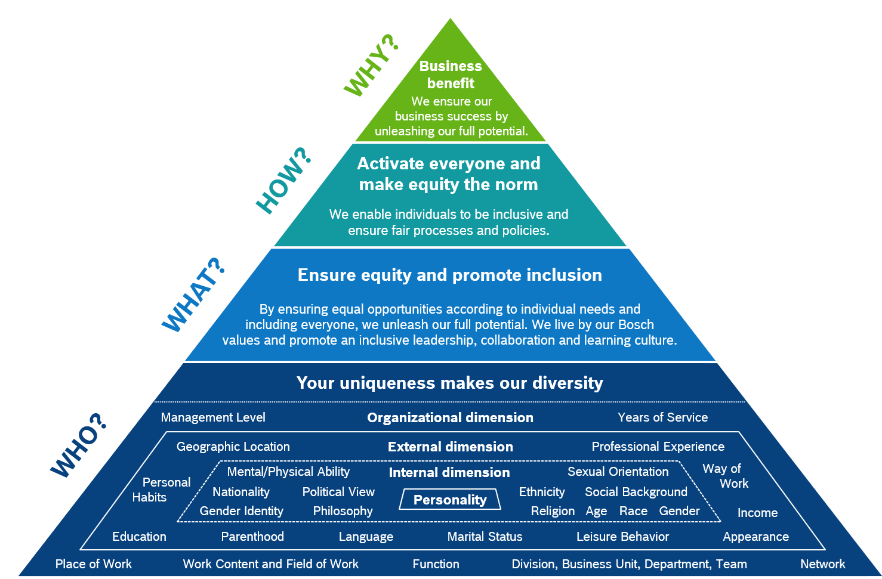
The Diversity Pyramid
Diversity, Equity and Inclusion in North America
The DEI pyramid describes how we approach diversity, equity an inclusion at Bosch and what steps we have to take, to really benefit from D E I.

Slide 18
What is Diversity?
Diversity, Equity and Inclusion in North America
What are some aspects that make you unique?

Slide 19
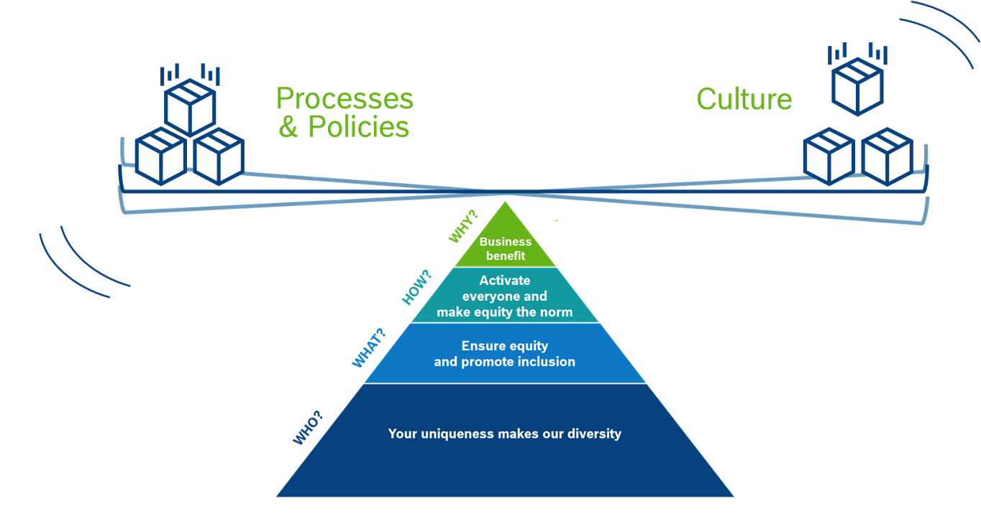
Our Balanced Approach
Diversity, Equity and Inclusion in North America
Balanced approach to ensure equal opportunities in processes & policies and drive an inclusive leadership-, learning & collaboration culture at Bosch!

Slide 20
Why We Value DEI
Diversity, Equity and Inclusion in North America
Innovative strength
by making use of talent
by increased creativity
Higher performance
by effective cooperation
by better decision making
Access to markets and customer orientation
Financial Performance (EBIT)
Gender Diversity
Ethnic Diversity
Higher associate motivation
and reduced employee turnover
Being an attractive employer
and better hiring results
25% more likely*
36% more likely*
* To outperform companies with homogenous executive teams
High belonging
50% drop in turnover risk
56% increase in job performance
75% reduction in sick days
Fischer 2009, Degele 2008: 159

Slide 21
Inclusion versus Belonging
Diversity, Equity and Inclusion in North America
Inclusion refers to behaviors, while belonging is a feeling that is an outcome of inclusive behaviors.
- Inclusalytics
Do you have an example of when you felt a strong sense of Belonging?

Slide 22
Women@Bosch
LGBTQ@Bosch
Veterans@Bosch
Generations@Bosch
Business Resource Groups
in North America
Asians@Bosch
Interfaith@Bosch
Hispanics@Bosch
AfricanAncestry@Bosch
BeAdept@Bosch

Slide 23
Questions
&
Answers

Slide 24
50/50 DRAWING
And the winner is …..?
This Photo by Unknown Author is licensed under CC BY

Slide 25
Four Way Test Of the things we think, Say AND DO
Is it the truth?
Is it fair to all concerned?
Will it build good will and better friendships?
Will it be beneficial to all concerned?

